Slide 1
Donor Me
An Application for Managing Blood and Organ Donation in Sri Lanka
Project ID : 2022_311
Supervisor : Ms. Uthpala Samarakoon
Project ID : 2022_311

Slide 2
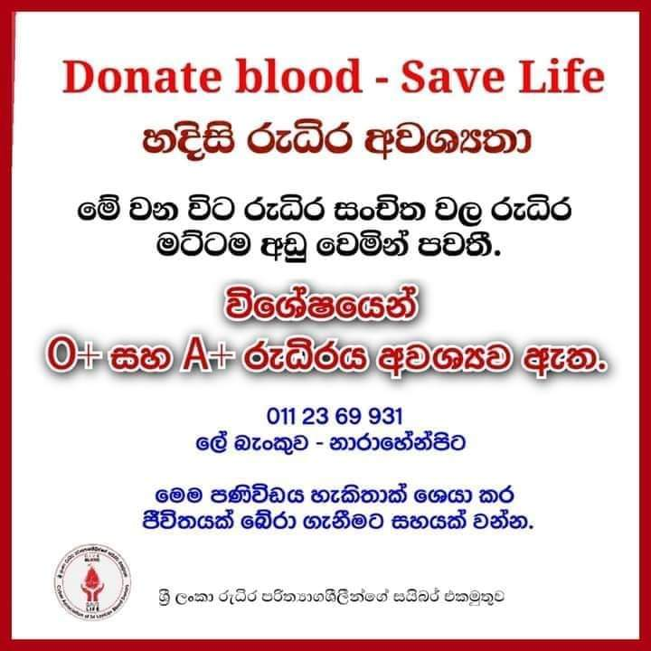

Slide 3
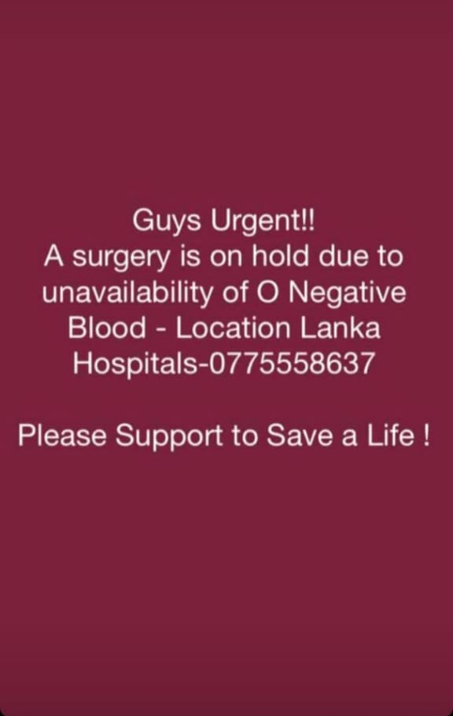

Slide 4
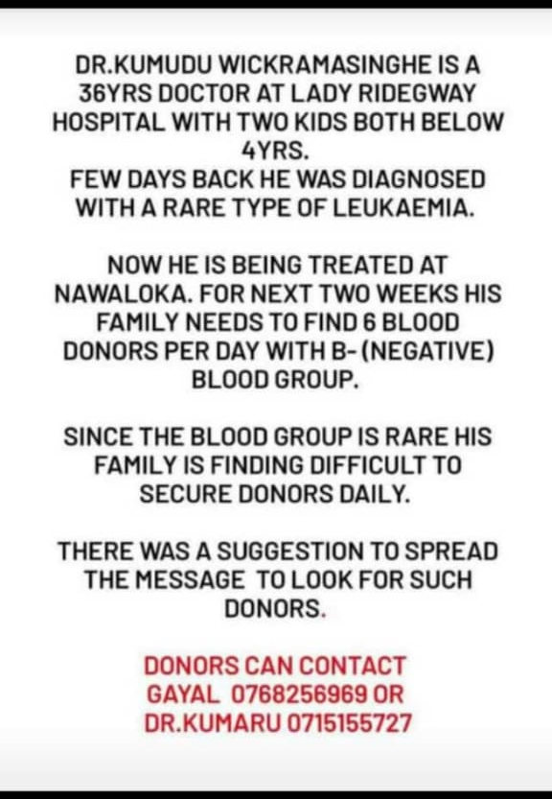

Slide 5
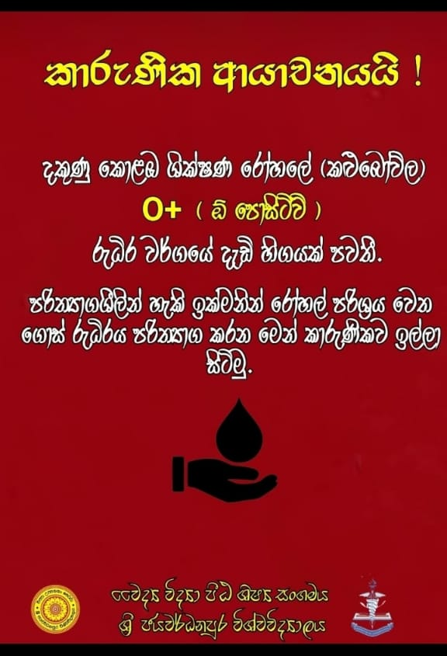

Slide 6

Still only 2.6% of Sri Lankans Donate Blood 22 people die everyday waiting for a transplant

Slide 7


Slide 8
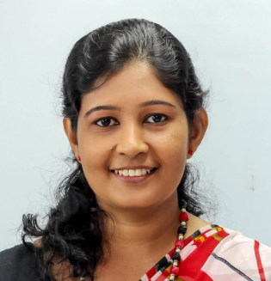
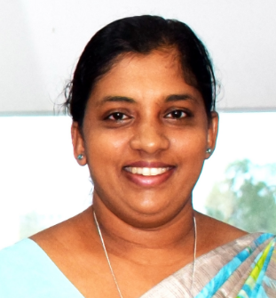
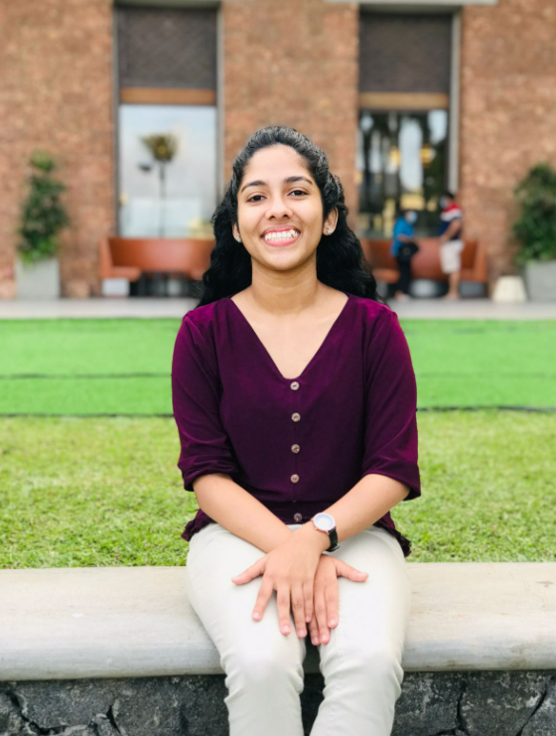
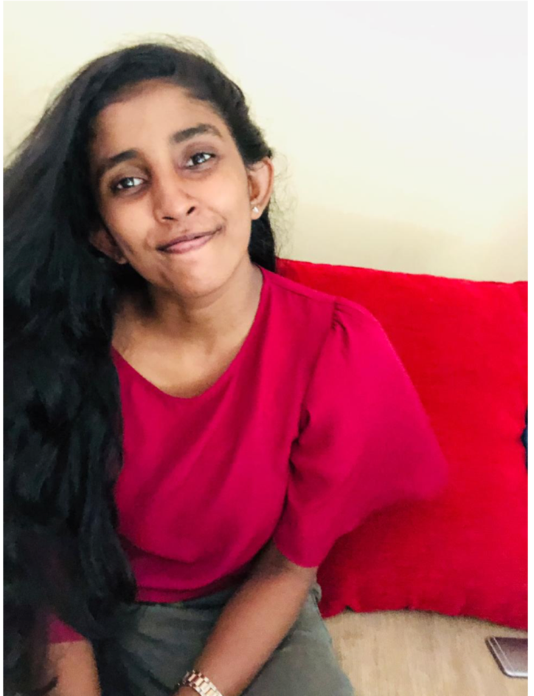
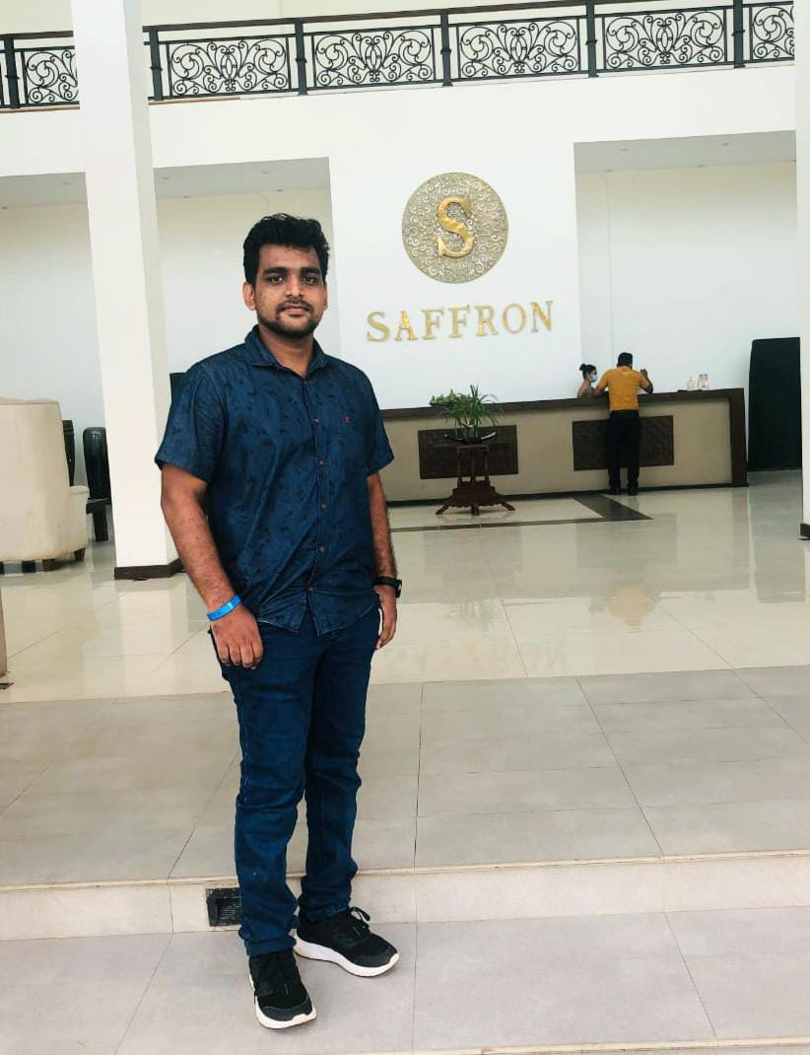
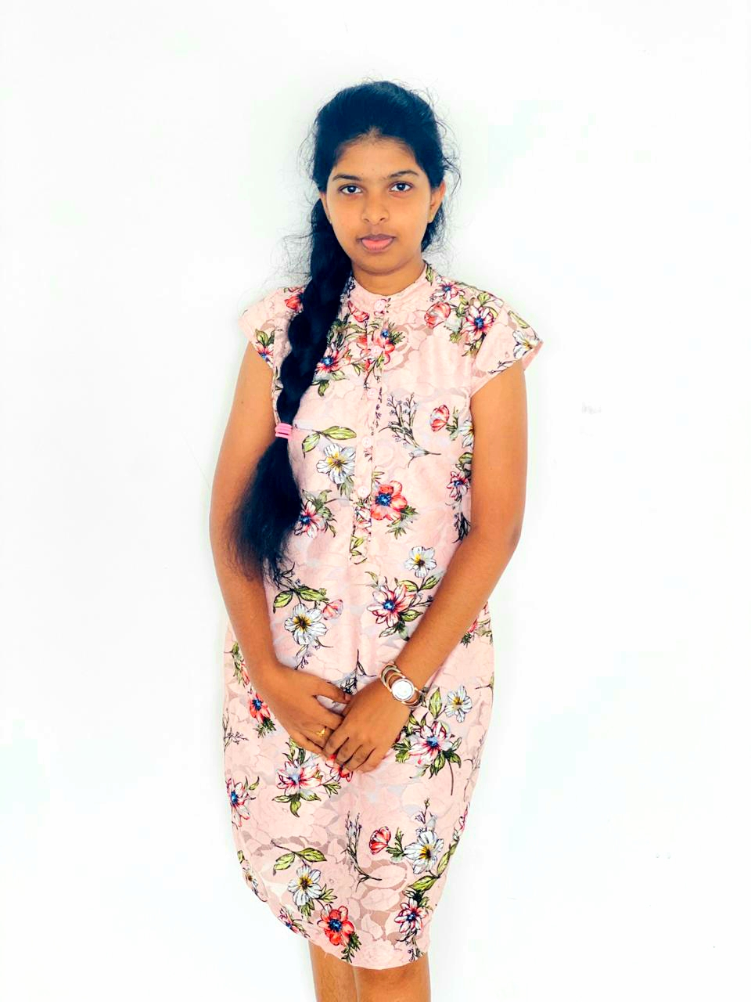
Our Team
Ms. Uthpala Samarakoon
Senior Lecturer
Sri Lanka Institute of Information Technology
Ms. Suriyaa Kumari
Lecturer
Sri Lanka Institute of Information Technology
R.M Sathma Dananjani
Undergratuate
Sri Lanka Institute of Information Technology
B.N Dullewa
Undergratuate
Sri Lanka Institute of Information Technology
K.D.R.O Bandara
Undergratuate
Sri Lanka Institute of Information Technology
Malkanthi P.M
Undergratuate
Sri Lanka Institute of Information Technology

Slide 9
Identified Problems ??
Emergency Blood Donation
Management & Managing Online Passbook

Slide 10
Identified Problems ??
Emergency Blood Donation
Management & Managing Online Passbook
Many medical comparisons are conducted between the donor and the donee in an Orgon transplant

Slide 11
Identified Problems ??
Many medical comparisons are conducted between the donor and the donee in an Orgon transplant
Emergency Blood Donation
Management & Managing Online Passbook
Manage The Blood Donation Camps Effectively

Slide 12
Identified Problems ??
Many medical comparisons are conducted between the donor and the donee in an Orgon transplant
Emergency Blood Donation
Management & Managing Online Passbook
Manage The Blood Donation Camps Effectively
Deficiency of future accesses ability of blood and lack of prediction

Slide 13
Donor Me ??
Donor me is a mobile application which builds the correspondence in between the donors and the respective donees efficiently by themselves. The Intelligent Blood and Organ Donation System mainly provides solutions for four major issues.

Slide 14
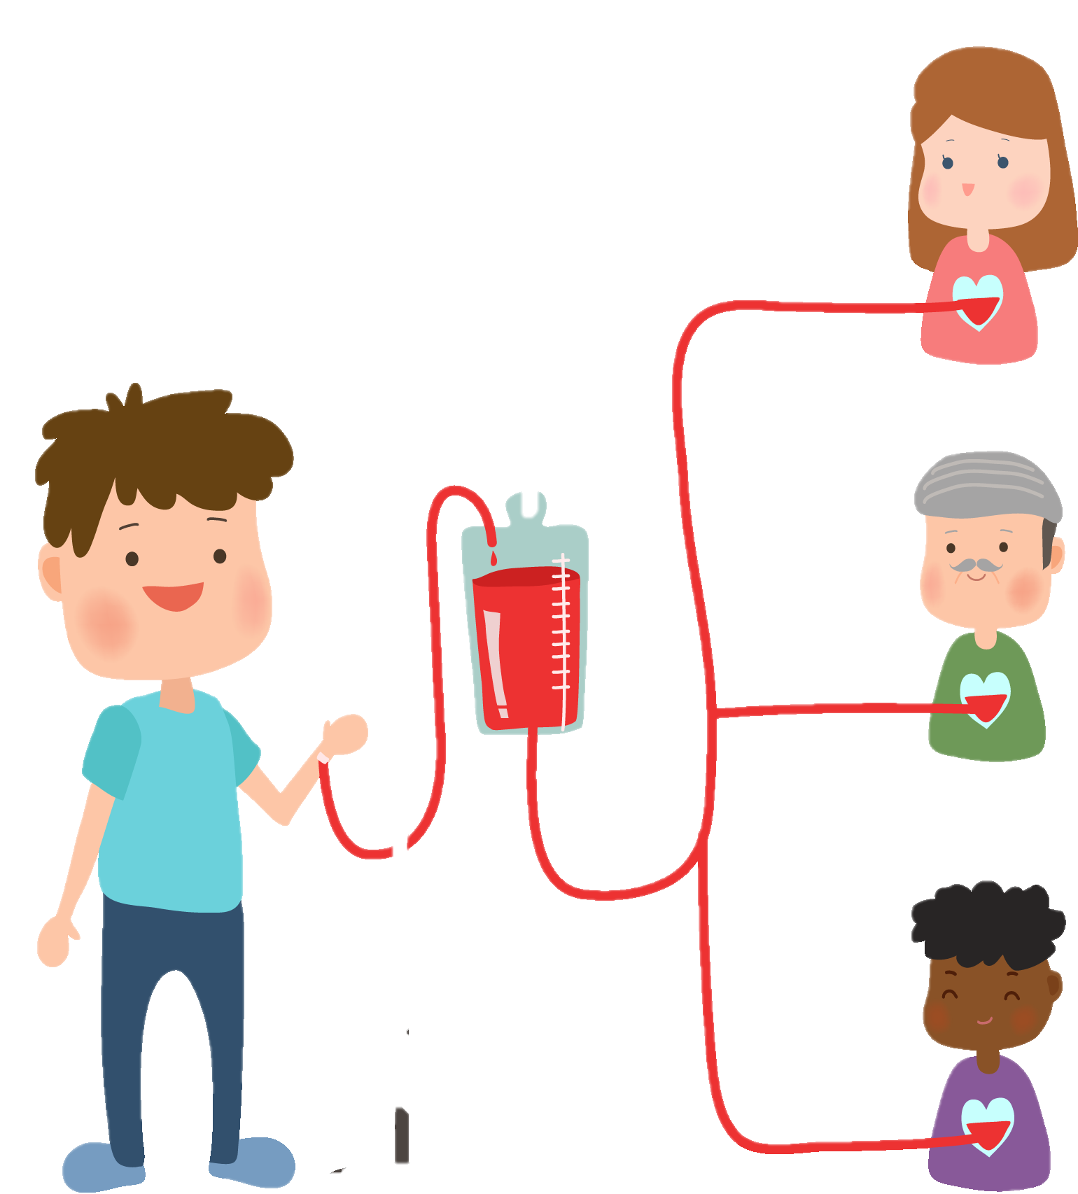
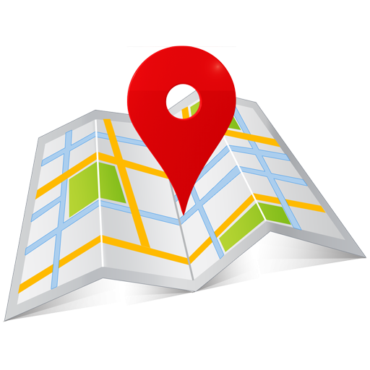
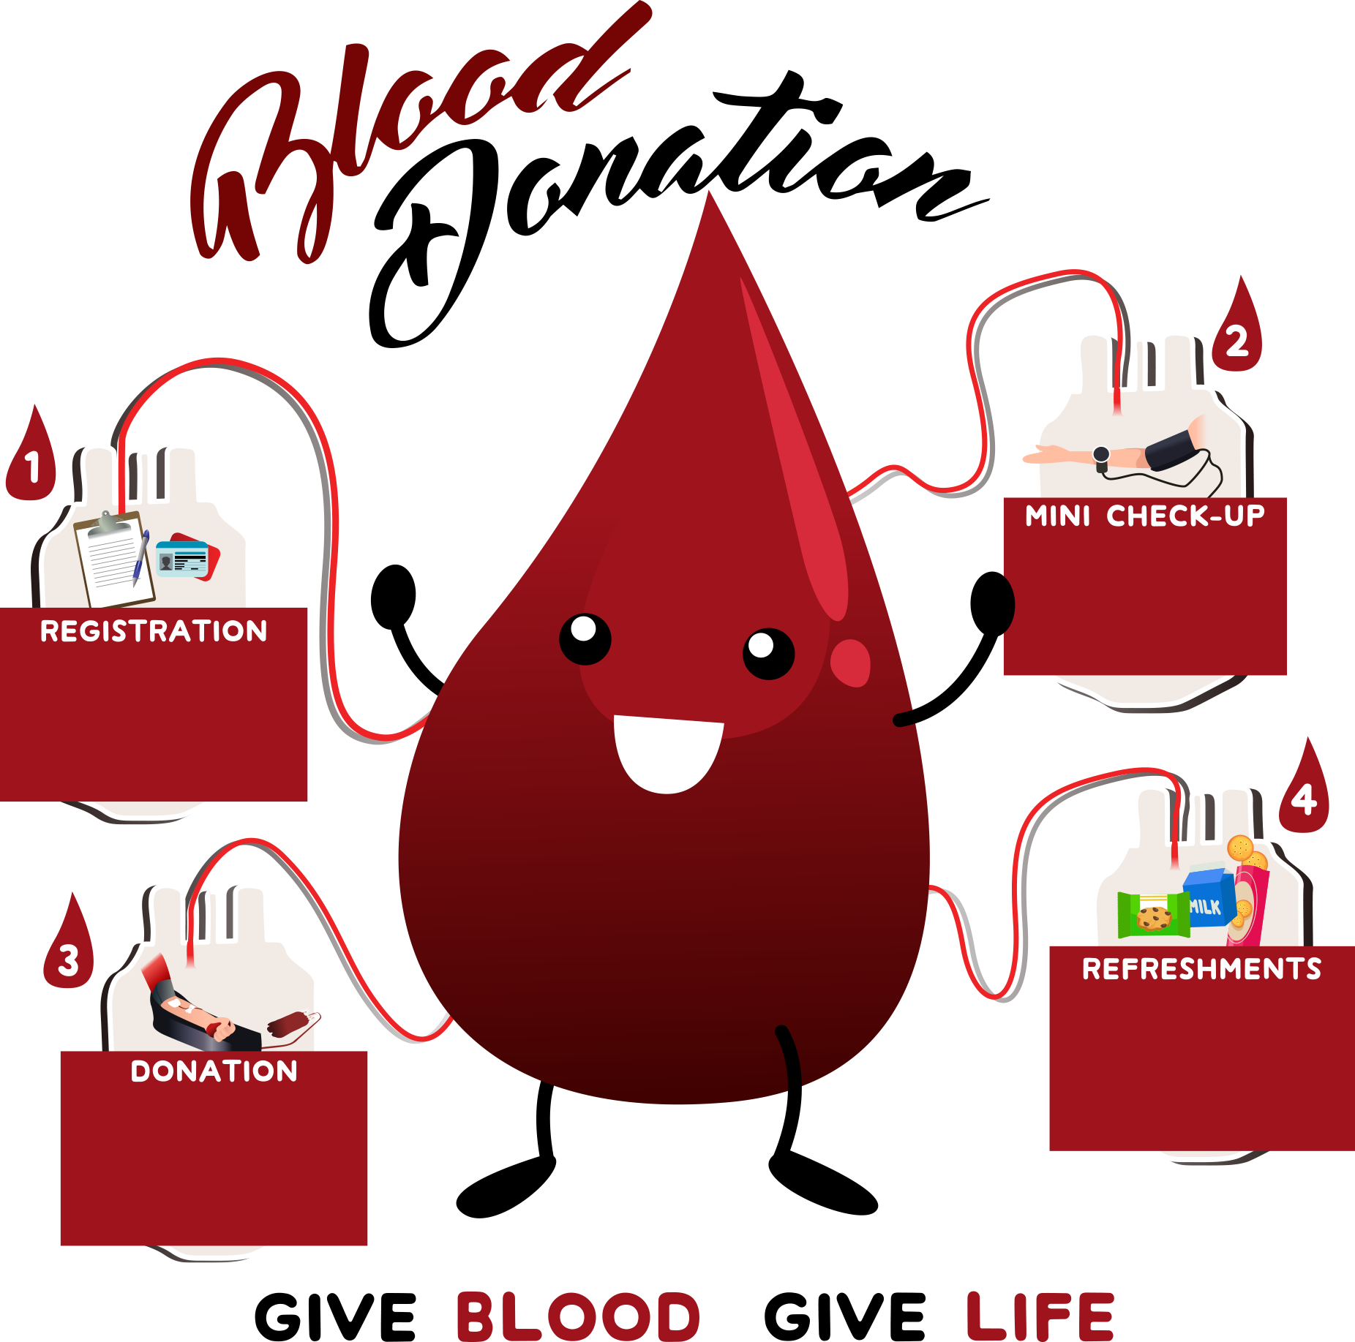


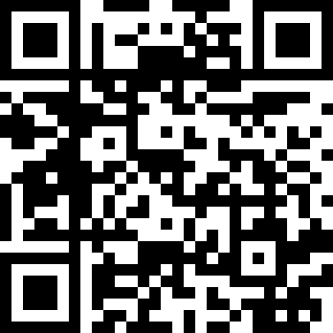
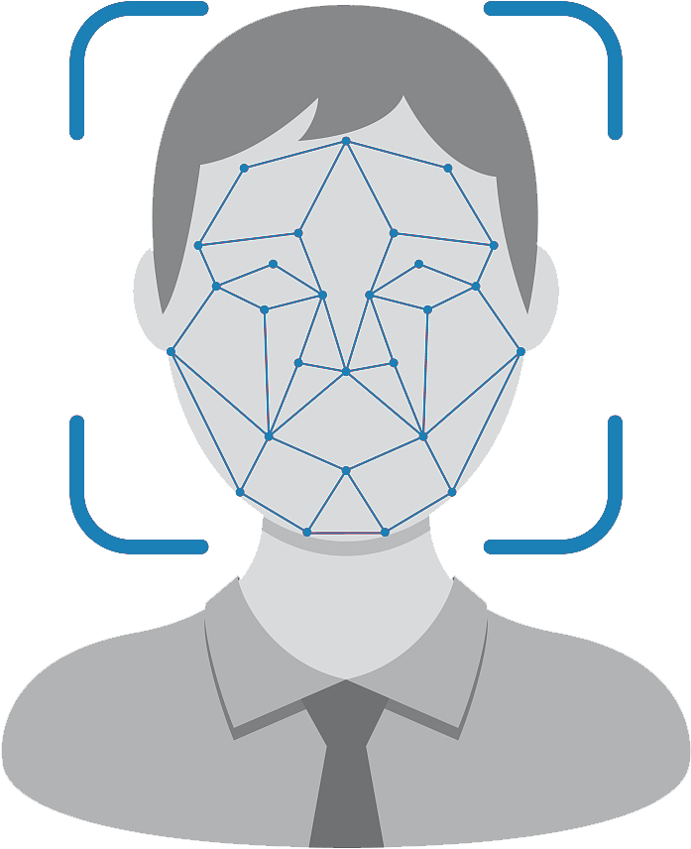
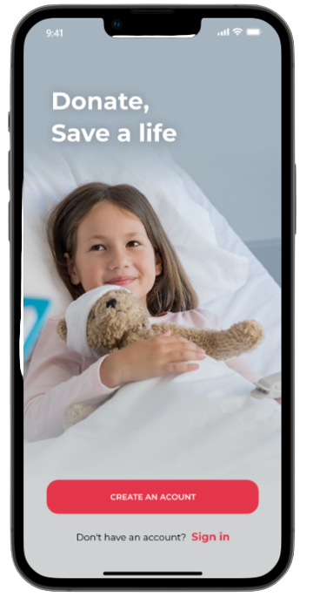

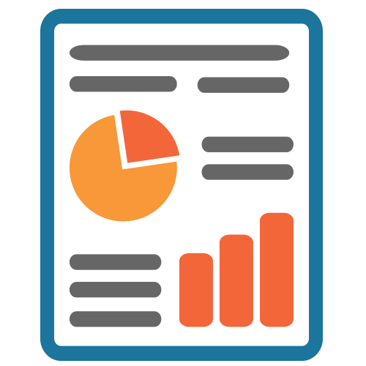



Our Solution
Blood Camp Organizing
Emergency Blood Donation
Select Proper Location
Create Blood donation Camp
Notified through and auto-generated message
Tracking The Blood Emergency Area
Send Notification Relevant Blood Group's Donors
Maintain The Online Passbook Via Accessing The QR Code and Face Detection
Create Blood Prediction Report
Organ Donation
Gathered Previous Blood reports
Create a Prediction Report
Send Notification,
Send Confirmation Message To The First Donor In the Queue
In an Emergency Donation, Can See The Location Of The Emergency Person,
The Donor And The Receiver Will Be Added To a Separate Chat Box
Accept The Confirmation

Slide 15
Objectives
The Prediction of blood for the future use
Manage the connection between the organ donors and donees in accordance with their requirements
Select the proper location to hold the blood donation camp
Manage the communication between the blood bank and the donors in accordance with their requirements

Slide 16
The Prediction of Blood for the future use

Slide 17
Research Questions
Deficiency of future accessibility of blood and lack of prediction?
IT19121734 | R.M.S.Dananjani 2022_311

Slide 18
Specific & Sub Objectives
Specific Objectives
The Prediction of blood for the future use.
Sub Objectives
The amount of Blood needed for each Hospital by the Blood bank is predicted by the System.
In which Times, selected Hospitals need more Blood than Regular months.
For A selected Hospital, the most and least wanted Blood Groups are predicted.
IT19121734 | R.M.S.Dananjani 2022_311

Slide 19
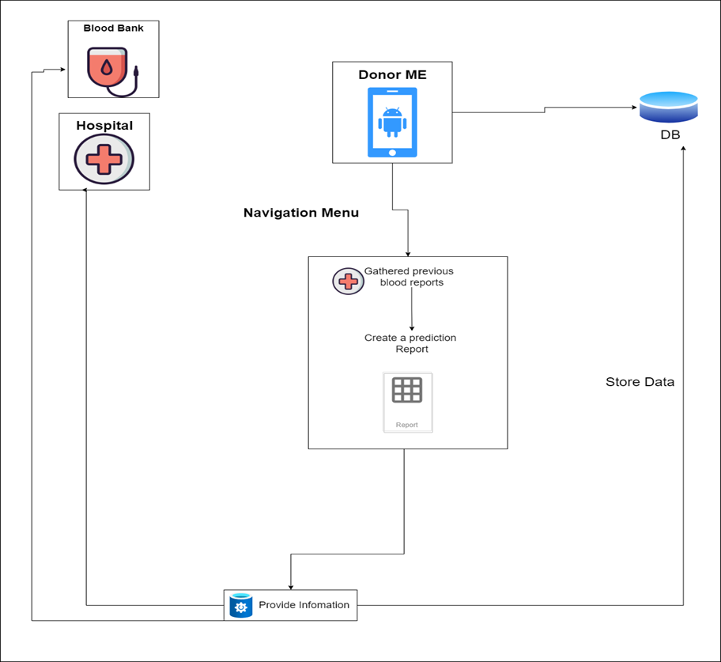
Methodology
IT19121734 | R.M.S.Dananjani 2022_311

Slide 20
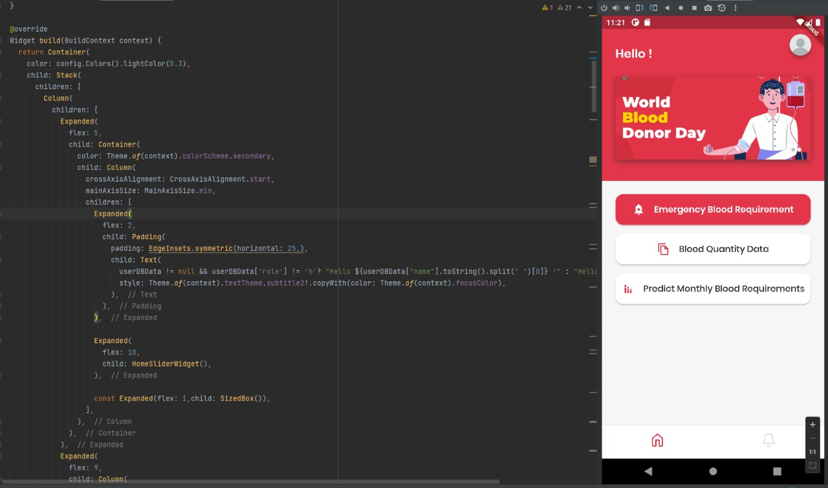
Evidence for the Completion
IT19121734 | R.M.S.Dananjani 2022_311

Slide 21
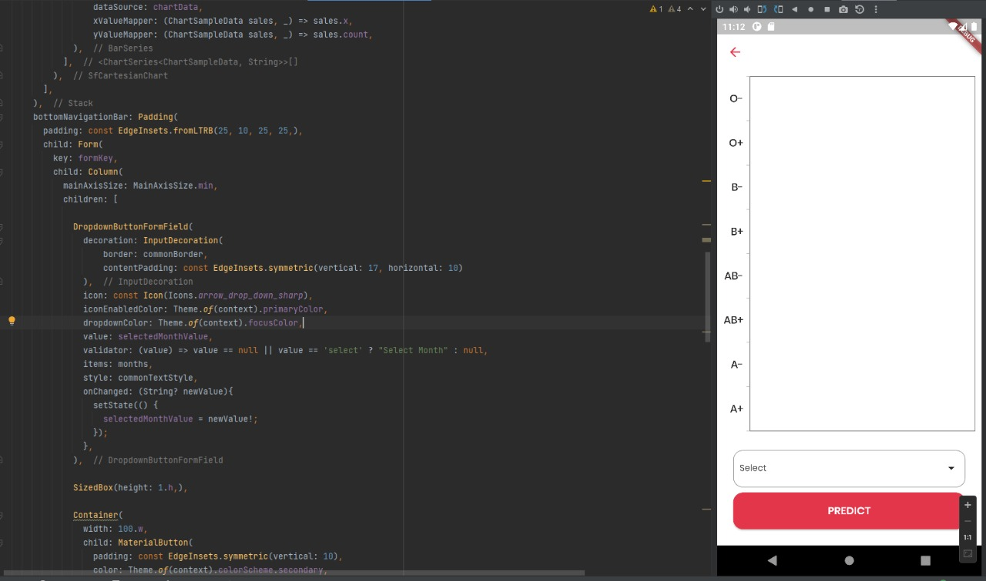
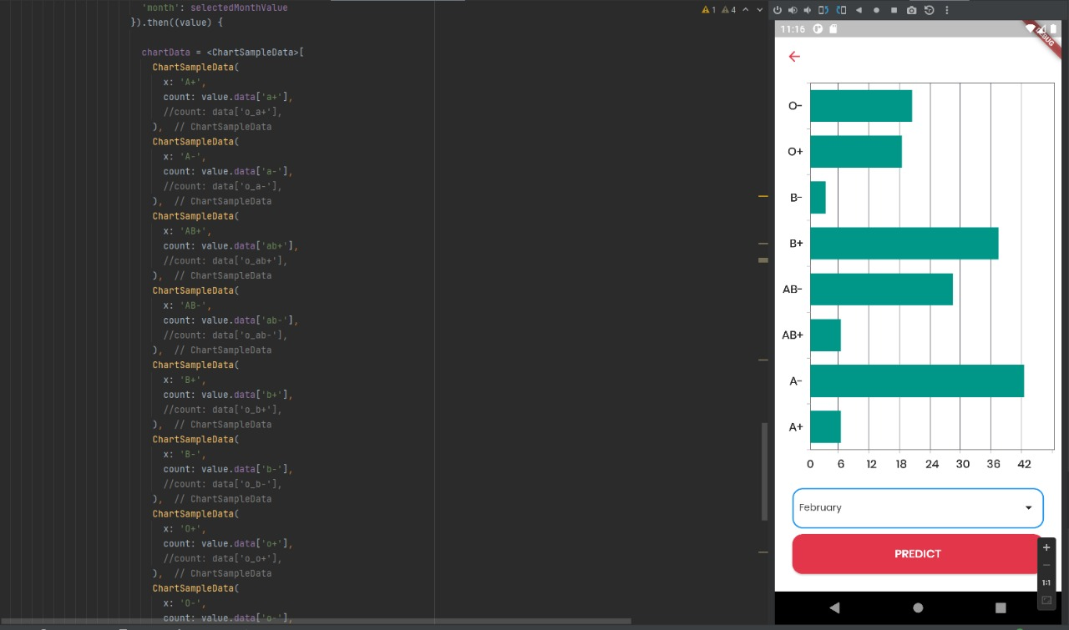
Evidence for the Completion
IT19121734 | R.M.S.Dananjani 2022_311

Slide 22
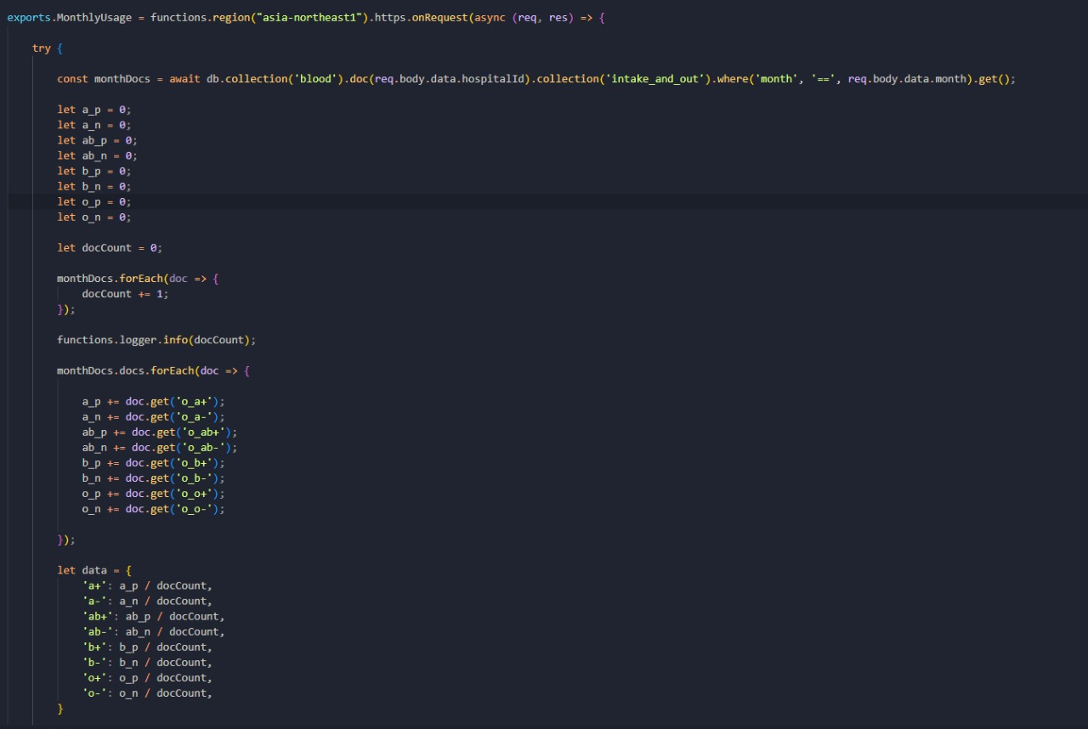
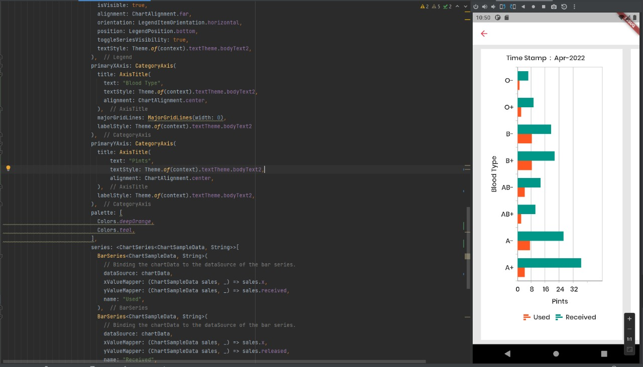
Evidence for the Completion
IT19121734 | R.M.S.Dananjani 2022_311

Slide 23
Completion of the project
90%
90%
Completed Task
Task to Do
IT19121734 | R.M.S.Dananjani 2022_311

Slide 24
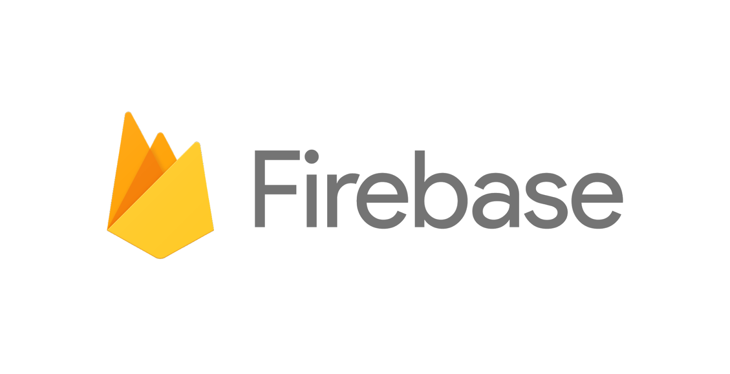



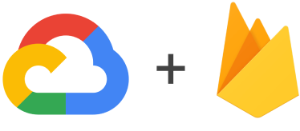
Technologies
IT19121734 | R.M.S.Dananjani 2022_311

Slide 25
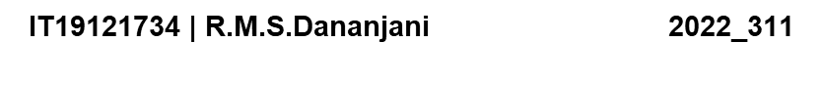
References
[1][. A. R, "Predictors of mortality after discharge in patients hospitalized with heart failure: An analysis from the Organized Program to Initiate Lifesaving Treatment in Hospitalized Patients with Heart Failure (OPTIMIZE-HF)," [Online]. Available: https://www.sciencedirect.com/science/article/abs/pii/S0002870308003232.
[2]A. A. Batis and A. Albarrak, “Preferences and features of a blood donation smartphone app: A multicenter mixed-methods study in Riyadh, Saudi Arabia,” Comput. Methods Programs Biomed. Updat., vol. 1, no. February, p. 100005, 2021, doi: 10.1016/j.cmpbup.2021.100005.
[4] b. A. Azad, "Blood Donation Camp organized by Student Council of BCAS Campus, Kalmunai," 16 August 2018. [Online].

Slide 26
Manage The Blood Donation Camps Effectively

Slide 27
Research Questions
How to locate the nearest blood donation camp ?
How to notified through an auto-generated message the potential donors ?
How to identify suitable location to hold a blood donation camp?
How do we manage to keep donor details confidentially?
How to get information about previous blood camps?
“I need to find a proper location for my blood donation camp”
Abdul , A Blood Donation Organizer
IT19112992 | B N Dullewa 2022_311

Slide 28
Specific & Sub Objectives
Specific Objectives
Select the proper location to hold the blood donation camp
Sub Objectives
Notified donor via auto generate message
Locate the nearest blood donation camp
Show the map to the user via google map
IT19112992 | B N Dullewa 2022_311

Slide 29
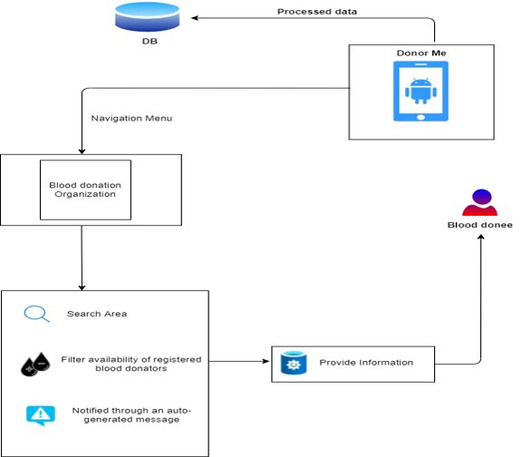
Methodology
IT19112992 | B N Dullewa 2022_311

Slide 30
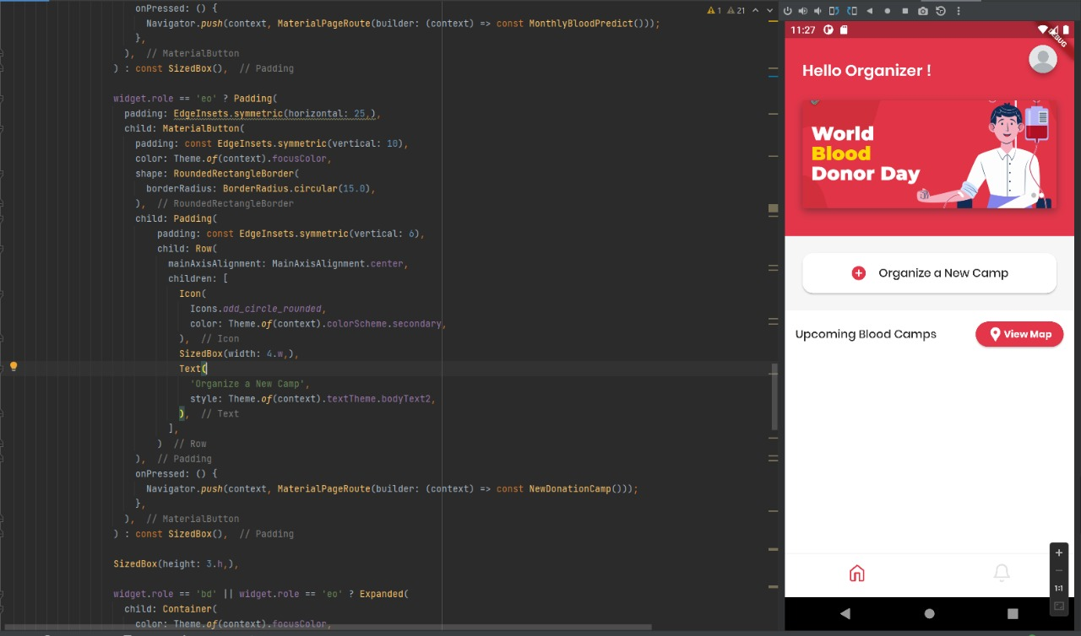
Evidence for the Completion
IT19112992 | B N Dullewa 2022_311

Slide 31
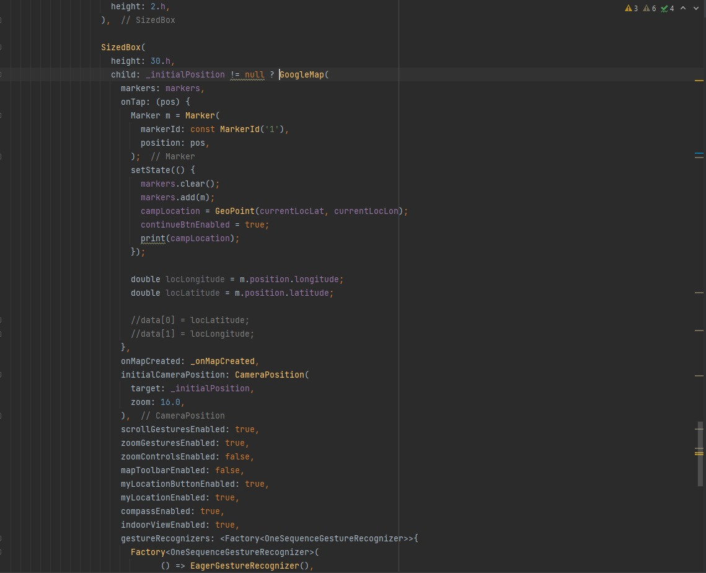
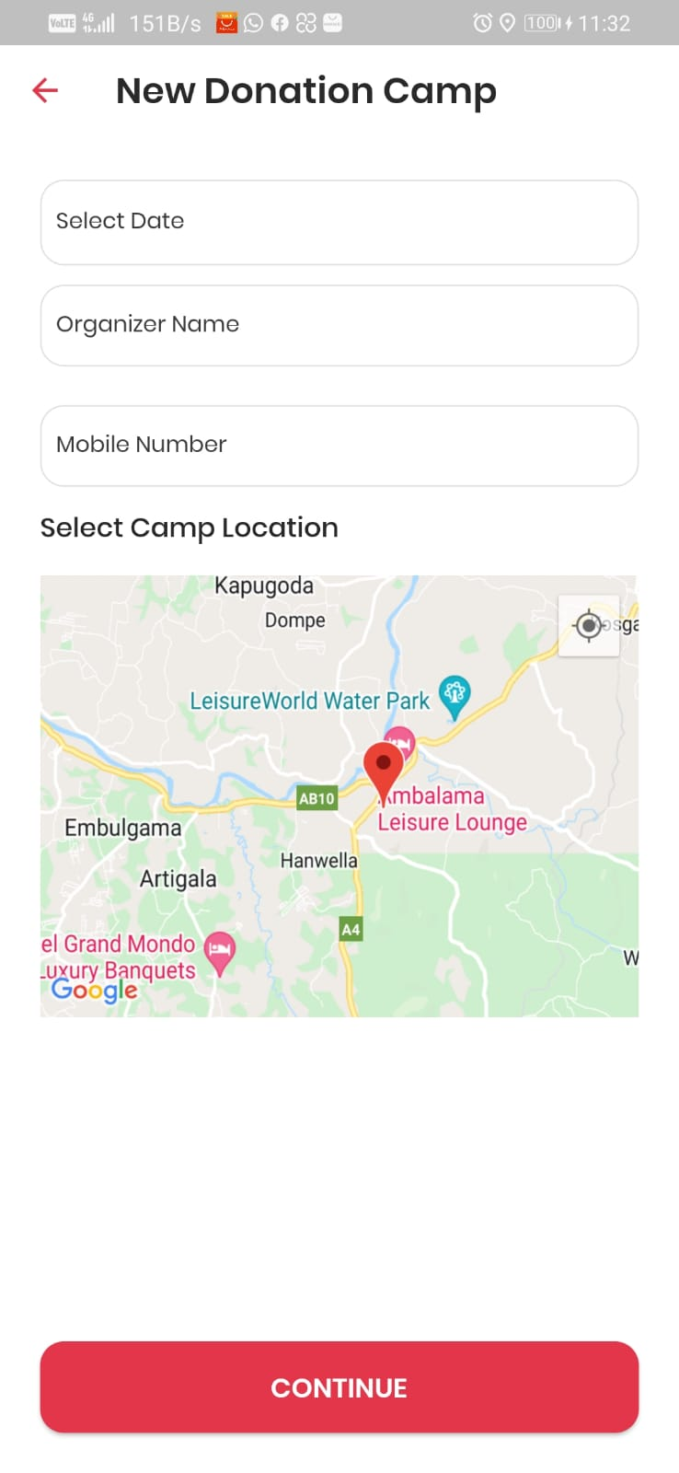
Evidence for the Completion
IT19112992 | B N Dullewa 2022_311

Slide 32
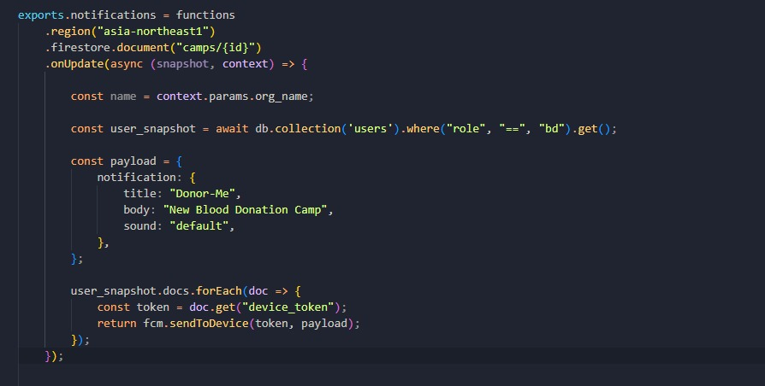
Evidence for the Completion
IT19112992 | B N Dullewa 2022_311

Slide 33
Completion of the project
60%
40%
Completed Task
Task to Do
IT19112992 | B N Dullewa 2022_311

Slide 34
Technologies
IT19112992 | B N Dullewa 2022_311

Slide 35
References
[1][Online]. Available: https://docs.microsoft.com/en-us/analysis-services/data-mining/data-mining-algorithms-analysis-services-data-mining?view=asallproducts-allversions.
[2] "Nation Libaray of medecine," 10 November 2021 . [Online]. Available: https://www.ncbi.nlm.nih.gov/pmc/articles/PMC8687008/.
[3]S. K. R. Nafis Ahmed1, "A guide to organizing a voluntary blood donation camp," [Online]. Available: http://www.ijbti.com/archive/2013-archive/100011IJBTINA2013-ahmed/100011IJBTINA2013-ahmed-full-text.php.
[4] b. A. Azad, "Blood Donation Camp organized by Student Council of BCAS Campus, Kalmunai," 16 August 2018. [Online].
IT19112992 | B.N Dullewa
2022_311

Slide 36
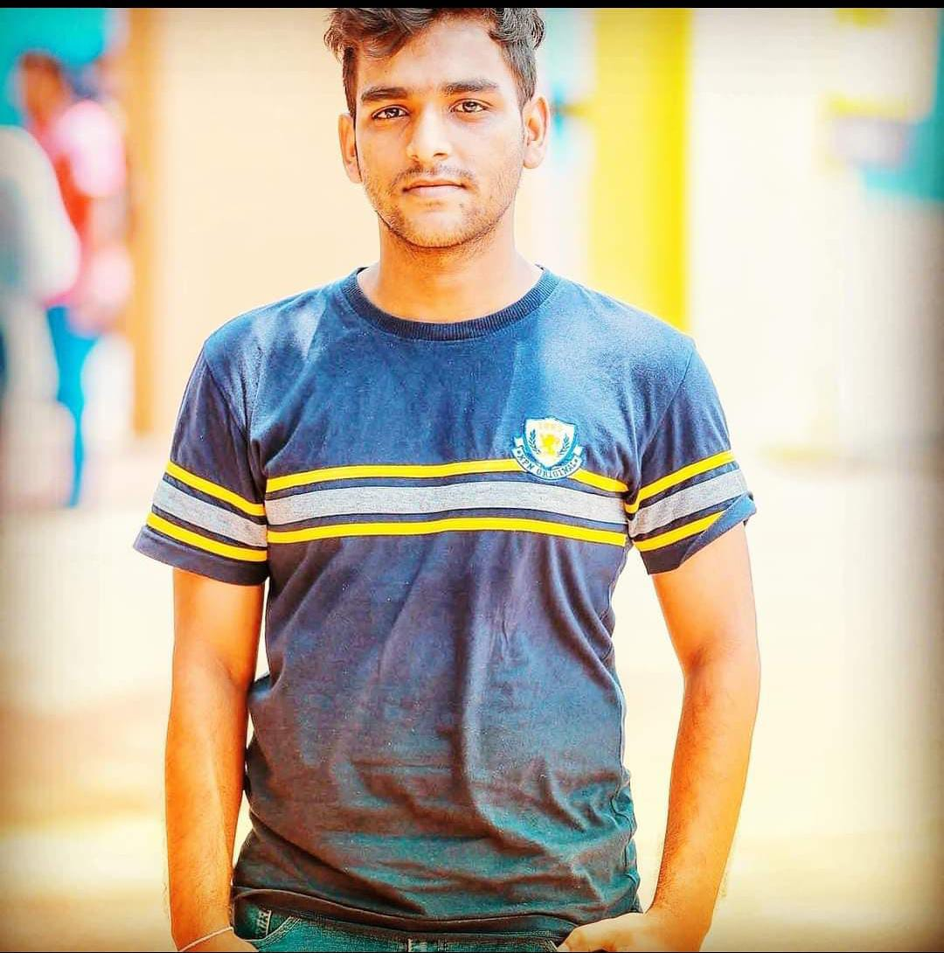
Create A Successful Correspondence In Between The Donors And The Donees​

Slide 37
Research Questions
How do Store Donors in a queue in order of registration? How to Send a confirmation message to the donor? How to create a Chatbot and real-time Message? How to enter the location using google map? How to send notifications to donors and donees?
IT19236438| K.U.R.O.D Bandara
2022_311

Slide 38
Specific & Sub Objectives
*Specific Objectives -Manage the connection between the organ donors and donees in accordance with their requirements *Sub Objectives -Send confirmation messages -create Chatbot and real-time Message -Manage and Send notifications to the registered organ donors and donees
IT19236438| K.U.R.O.D Bandara
2022_311

Slide 39
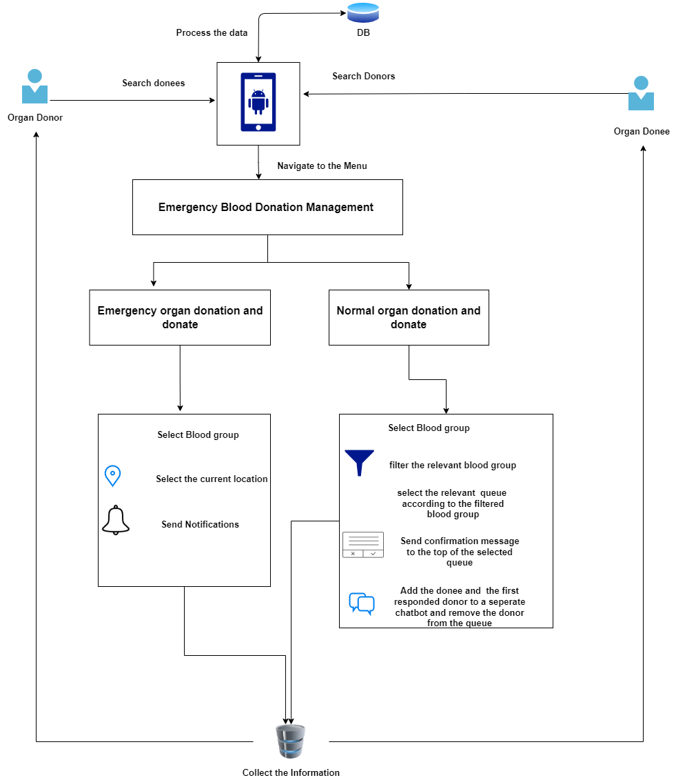
Methodology
IT19236438| K.U.R.O.D Bandara
2022_311

Slide 40
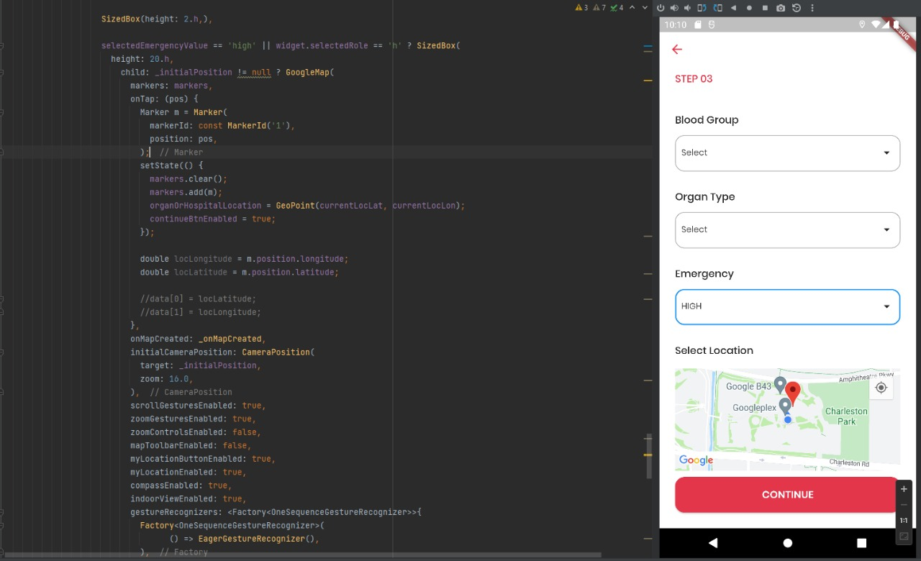
Evidence for the Completion
IT19236438 | K.U.R.O.D Bandara 2022_311

Slide 41
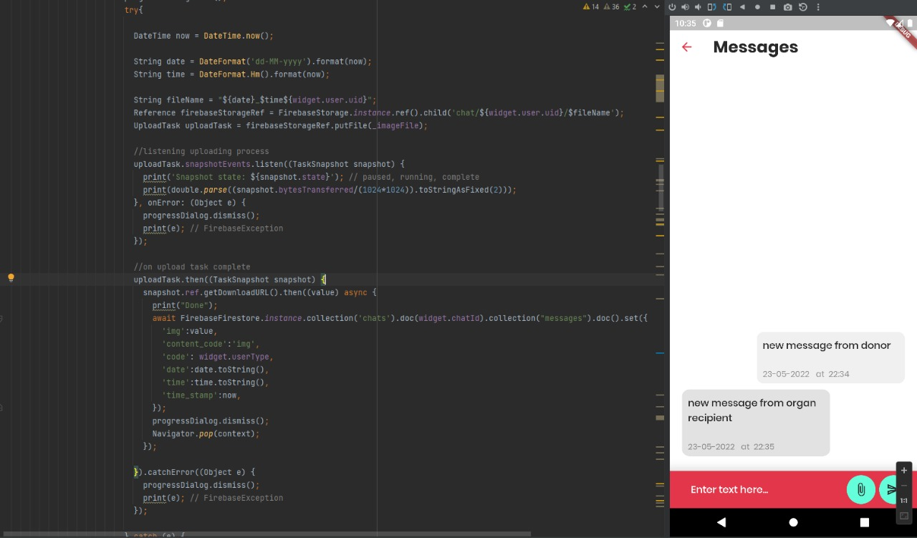
Evidence for the Completion
IT19236438 | K.U.R.O.D Bandara 2022_311

Slide 42
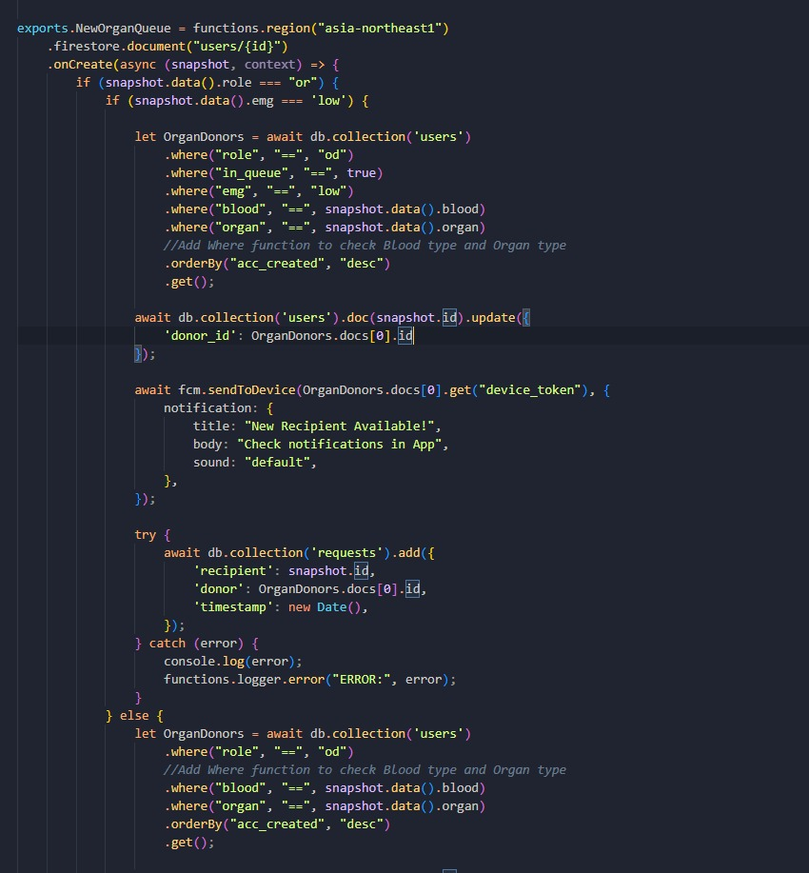
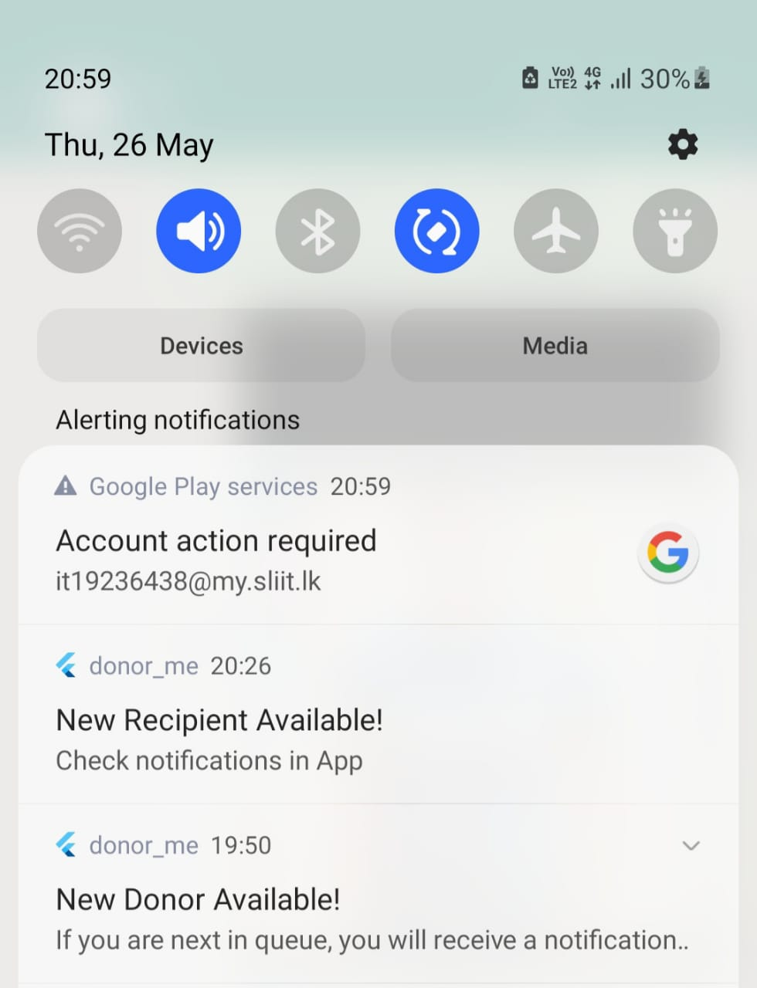
Evidence for the Completion
IT19236438 | K.U.R.O.D Bandara 2022_311

Slide 43
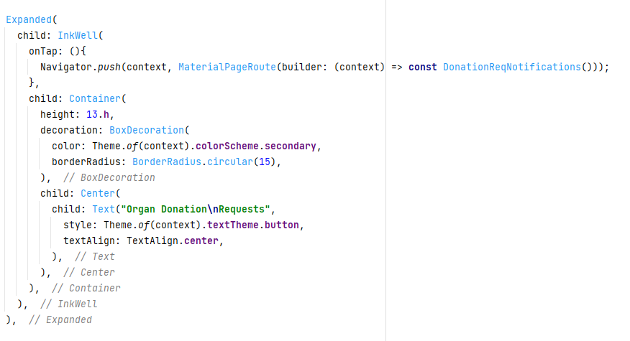
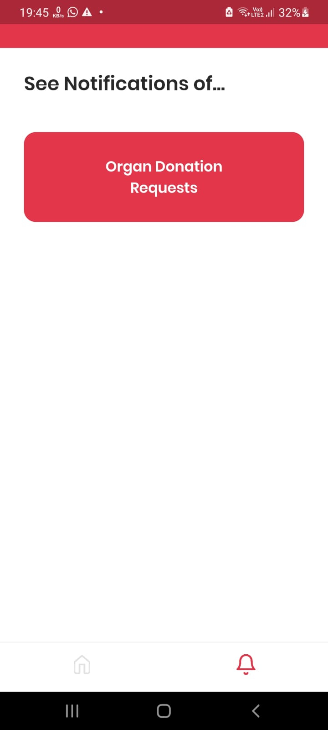
Evidence for the Completion
IT19236438 | K.U.R.O.D Bandara 2022_311

Slide 44
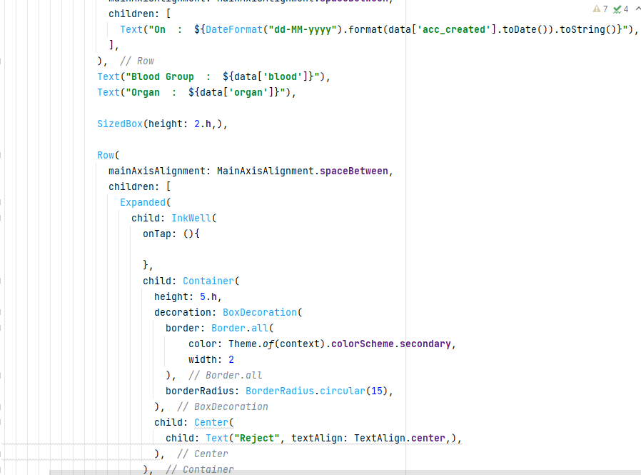
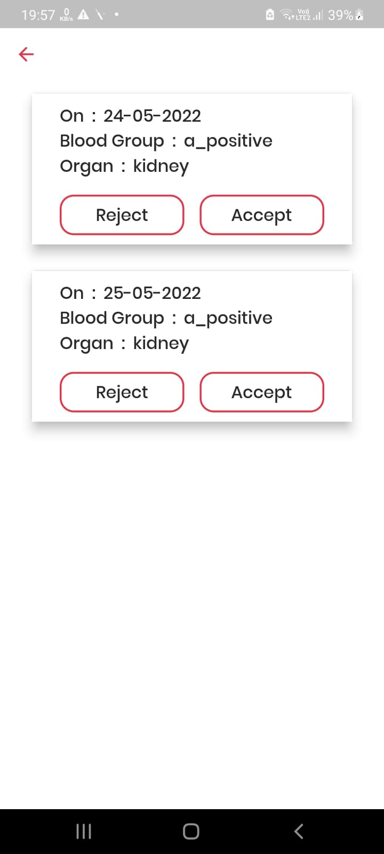
Evidence for the Completion
IT19236438 | K.U.R.O.D Bandara 2022_311

Slide 45
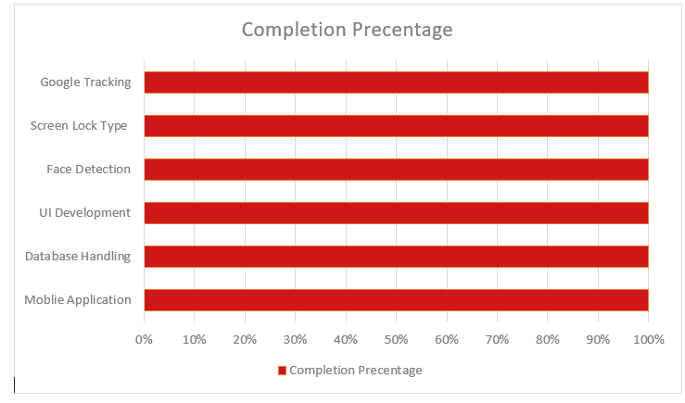
Completion of the project
100%
Completion Of My Sections
IT19236438 | K.U.R.O.D Bandara
2022_311

Slide 46
Technologies
IT19236438 | K.U.R.O.D Bandara
2022_311

Slide 47
References
[1] S. Ouhbi, J. L. Fernández-Alemán, A. Toval, A. Idri, and J. R. Pozo, “Free Blood Donation Mobile Applications,” J. Med. Syst., vol. 39, no. 5, pp. 1–20, 2015, doi: 10.1007/s10916-015-0228-0.
[2]A. A. Batis and A. Albarrak, “Preferences and features of a blood donation smartphone app: A multicenter mixed-methods study in Riyadh, Saudi Arabia,” Comput. Methods Programs Biomed. Updat., vol. 1, no. February, p. 100005, 2021, doi: 10.1016/j.cmpbup.2021.100005.
IT19236438 | K.U.R.O.D Bandara
2022_311

Slide 48
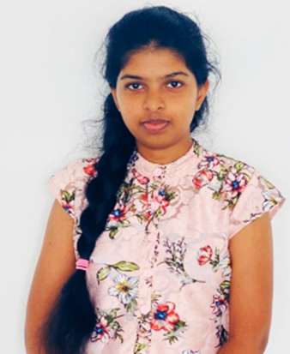
Emergency Blood Donation
Management & Managing Online Passbook
Specialization In Information Technology

Slide 49
Research Questions
How to verify the passbook through the face ID? How to authenticate mobile phone’s screen lock type? How to generate QR code? How to send messages by filtering eligible donors? How to tracking donors using google map?
IT19115108 | Malkanthi.P.L
2022_311

Slide 50
Specific & Sub Objectives
Specific Objectives -Manage the communication between the blood bank and the donors in accordance with their requirements Sub Objectives
-Send notifications to the registered eligible donors, by using google map -Provide an online passbook -Verification of the passbook through the face ID & screen lock type -Automatically update the donation records in passbook by scanning the QR code
IT19115108 | Malkanthi.P.L
2022_311

Slide 51
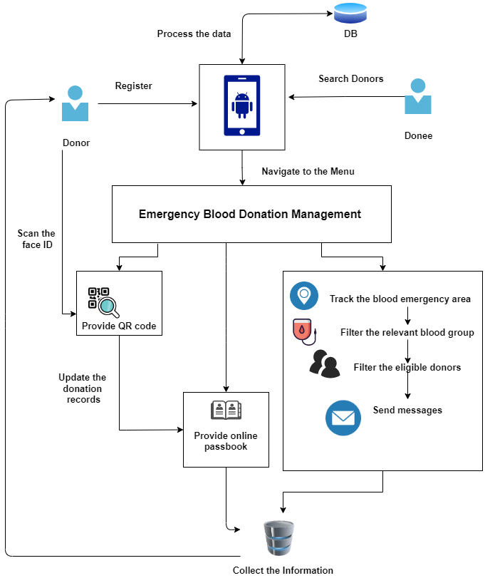
Methodology
IT19115108 | Malkanthi.P.L
2022_311

Slide 52
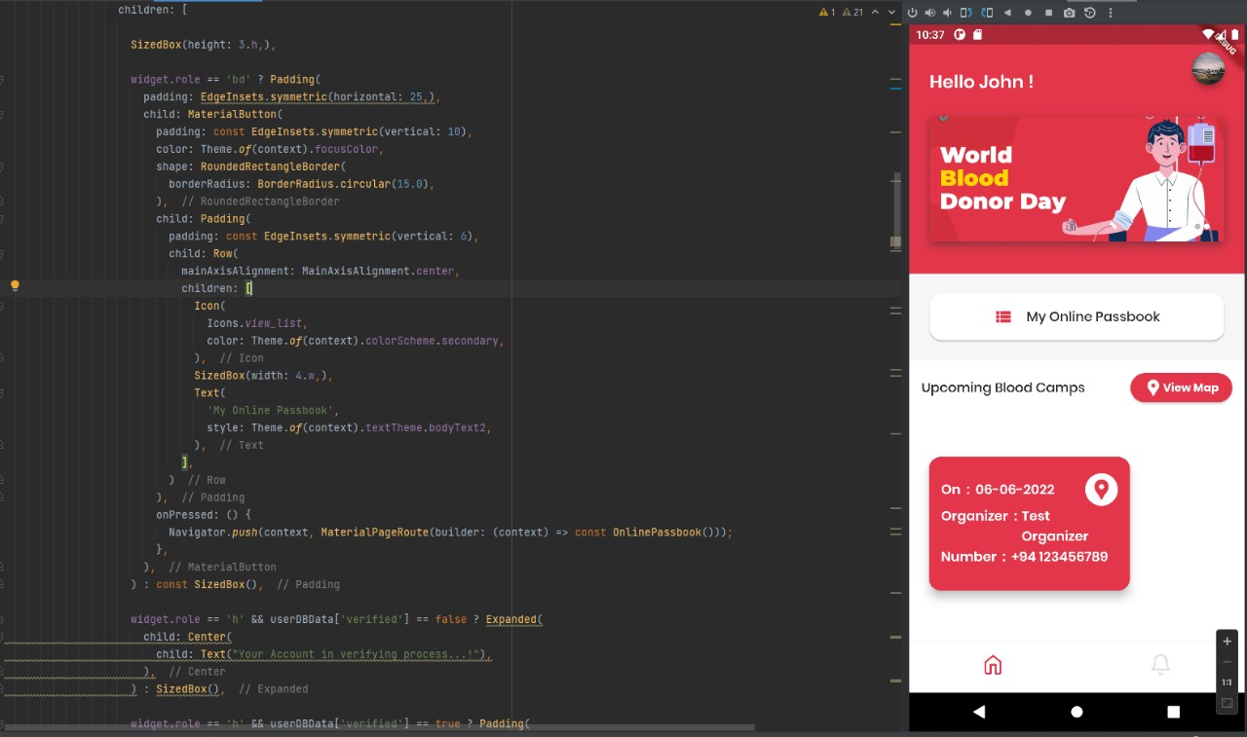
Evidence for the Completion
IT19115108 | Malkanthi.P.L
2022_311

Slide 53
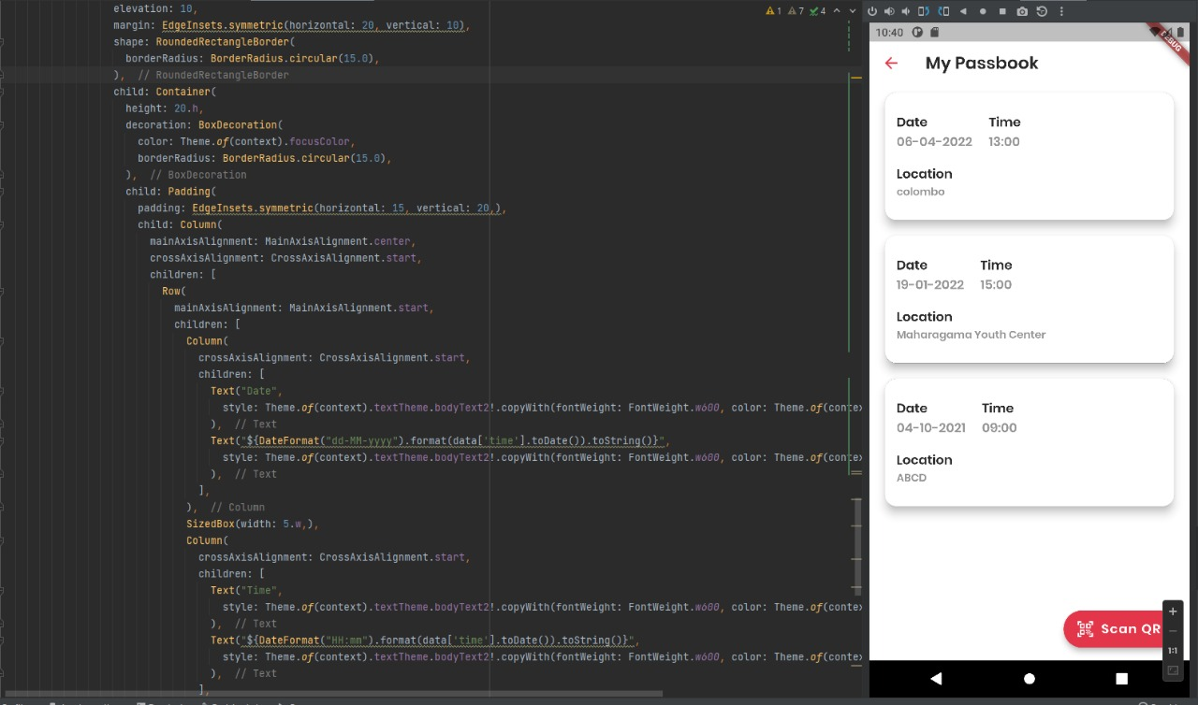
Evidence for the Completion
IT19115108 | Malkanthi.P.L
2022_311

Slide 54
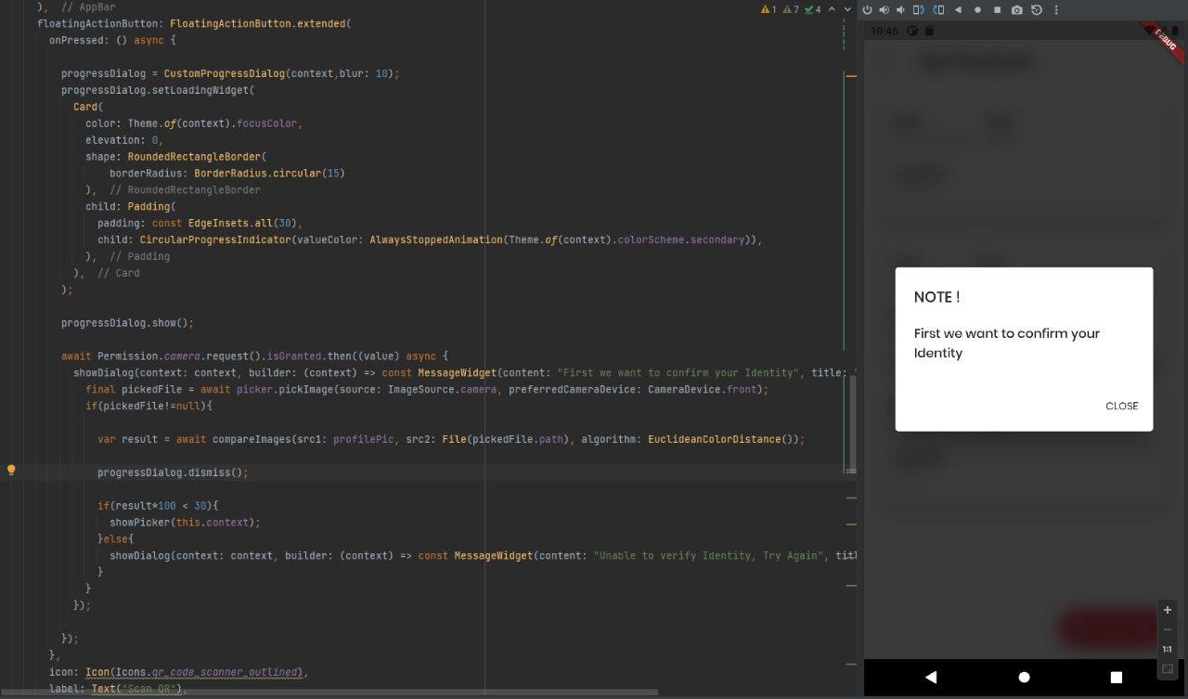
Evidence for the Completion
IT19115108 | Malkanthi.P.L
2022_311

Slide 55
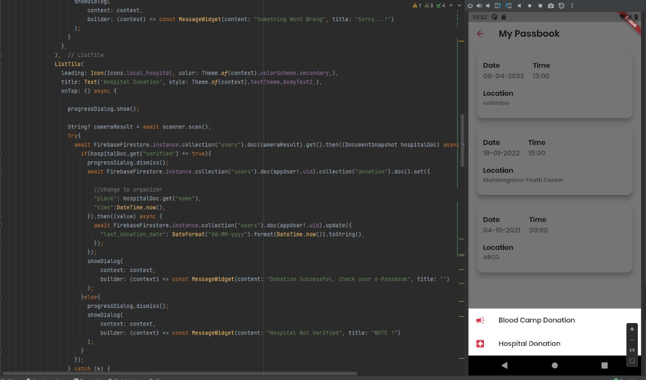
Evidence for the Completion
IT19115108 | Malkanthi.P.L
2022_311

Slide 56
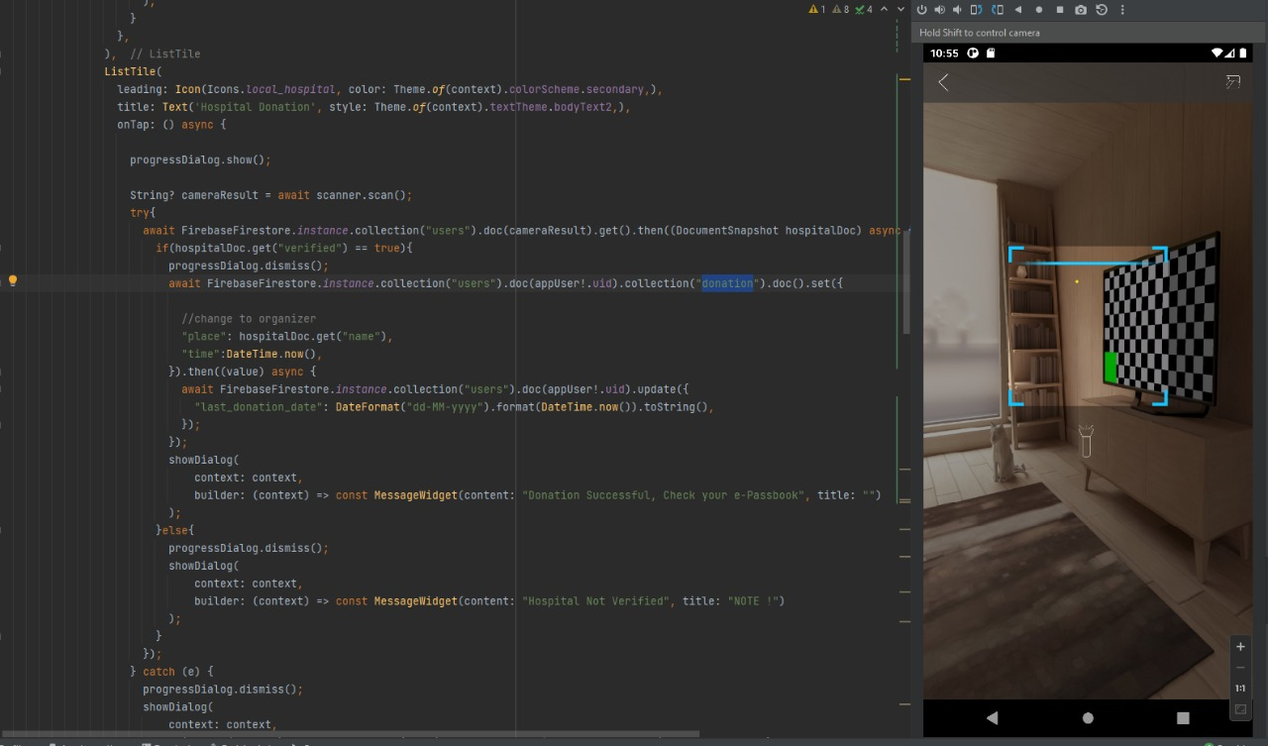
Evidence for the Completion
IT19115108 | Malkanthi.P.L
2022_311

Slide 57
Completion of the project
100%
Completion Of My Sections
IT19115108 | Malkanthi.P.L
2022_311

Slide 58
Technologies
IT19115108 | Malkanthi.P.L
2022_311

Slide 59
References
[1] S. Ouhbi, J. L. Fernández-Alemán, A. Toval, A. Idri, and J. R. Pozo, “Free Blood Donation Mobile Applications,” J. Med. Syst., vol. 39, no. 5, pp. 1–20, 2015, doi: 10.1007/s10916-015-0228-0.
[2]A. A. Batis and A. Albarrak, “Preferences and features of a blood donation smartphone app: A multicenter mixed-methods study in Riyadh, Saudi Arabia,” Comput. Methods Programs Biomed. Updat., vol. 1, no. February, p. 100005, 2021, doi: 10.1016/j.cmpbup.2021.100005.
[3]R. L. Hsu, M. Abdel-Mottaleb, and A. K. Jain, “Face detection in color images,” IEEE Trans. Pattern Anal. Mach. Intell., vol. 24, no. 5, pp. 696–706, 2002, doi: 10.1109/34.1000242.
IT19115108 | Malkanthi.P.L
2022_311

Slide 60

Business Model
Free Offering
Premium Offering
- Contain Ads
- Not - Contain Ads

Slide 61
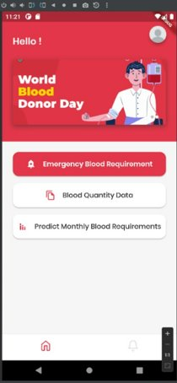


Donor Me Product Demonstration

Slide 62

Thank You!

